Slide 1
SF Energy Benchmarking
Prepared by Linh Pham

Slide 2
Background
Energy use intensity (EUI) - energy per square foot per year. A low EUI indicates good energy performance. EUI level are based on the following factors:
Based on different building categories
Based on building’s area
Based on building age

Slide 3
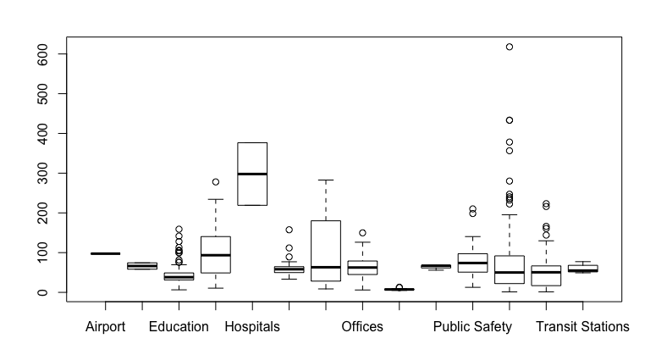
EUI vs. Building Categories

Slide 4
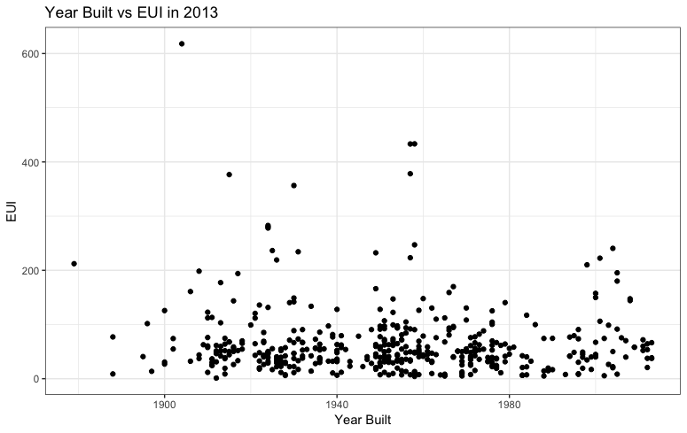
EUI vs. Year Built

